Slide 1

WEB TECHNOLOGY
(12 MAY 2018)
By Parveen kaur
Assistant Professor

Slide 2

The HTML Style Attribute

Slide 3
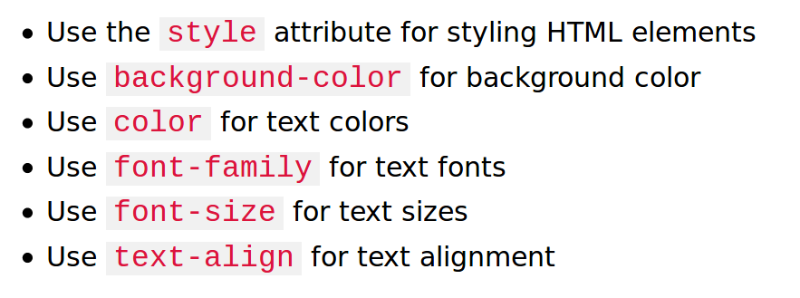
The HTML Style Attribute

Slide 4
The HTML Style Attribute
The HTML style attribute has the following syntax:
<tagname style="property:value;">
Example:
<body style="background-color:powderblue;"></body>
<h1 style="color:blue;">This is a heading</h1>
<p style="color:red;">This is a paragraph.</p>
<h1 style="font-family:verdana;">This is a heading</h1>
<p style="font-family:courier;">This is a paragraph.</p>
<h1 style="font-size:300%;">This is a heading</h1>
<h1 style="text-align:center;">Centered Heading</h1>

Slide 5
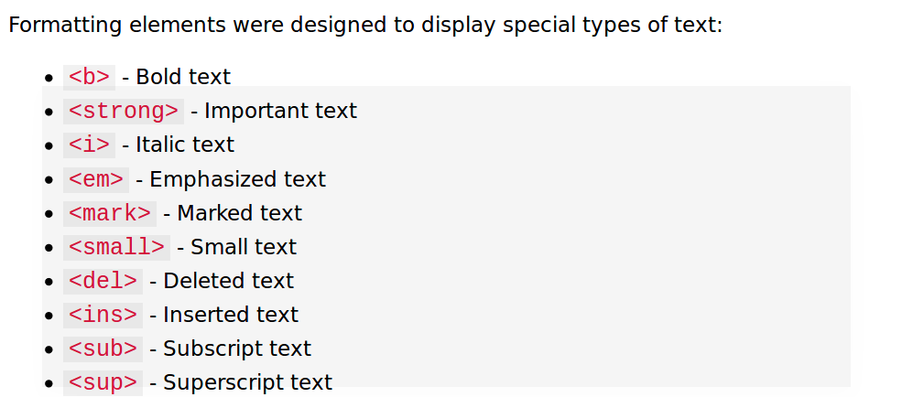
Formatting Tags

Slide 6
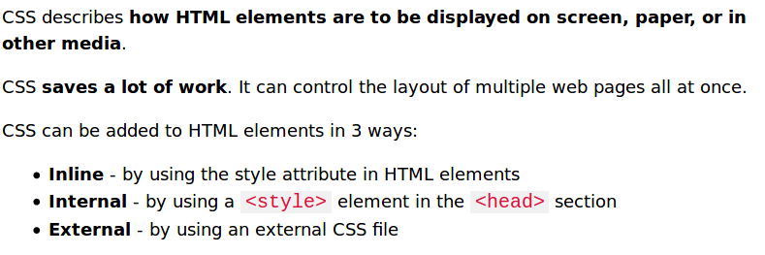
CSS(Cascading Style sheets)

Slide 7
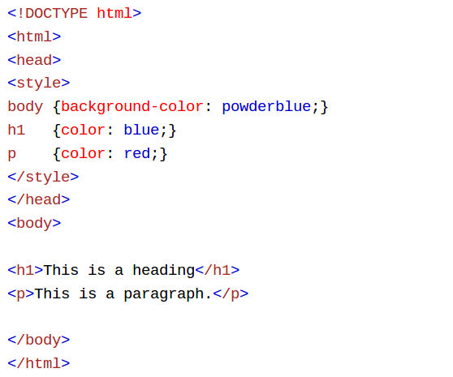
Internal CSS

Slide 8
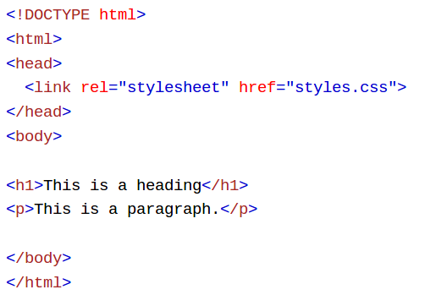
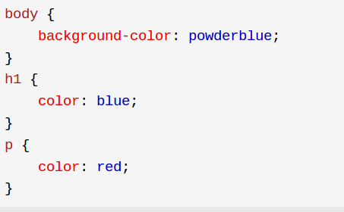
External CSS

Slide 9
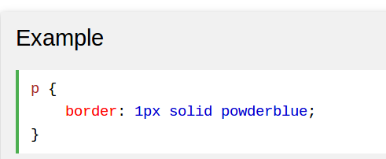
CSS Border

Slide 10
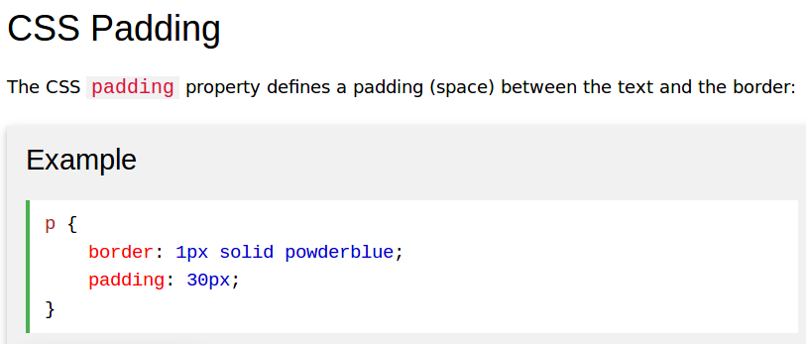

Slide 11
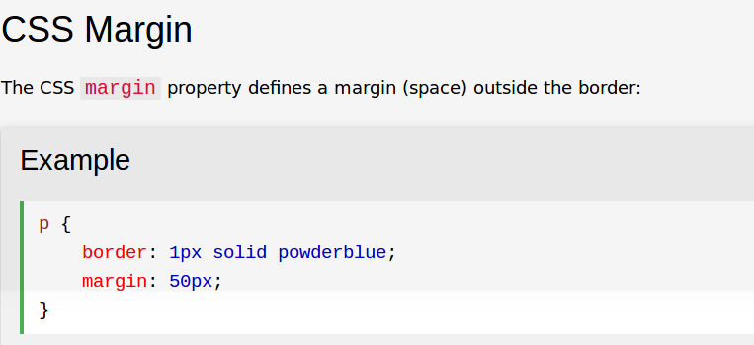

Slide 12
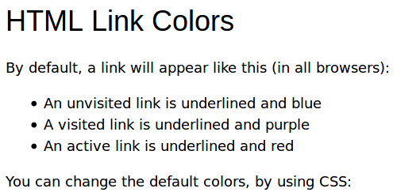
<style>
a:link {
color: white;
background-color: blue;
text-decoration: none;
}
a:visited {
color: pink;
background-color: transparent;
text-decoration: none;
}
a:hover {
color: red;
background-color: transparent;
text-decoration: underline;
}
a:active {
color: yellow;
background-color: transparent;
text-decoration: underline;
}
</style>

Slide 13
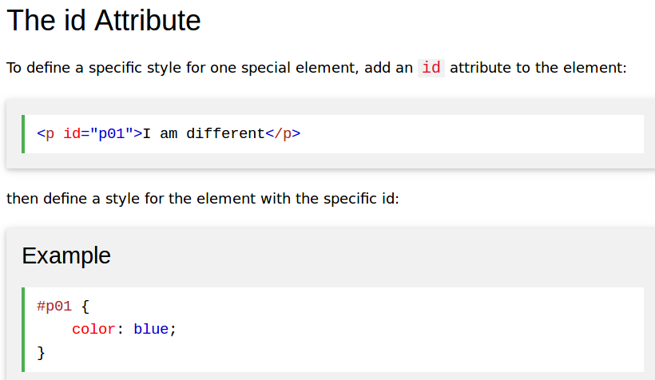

Slide 14
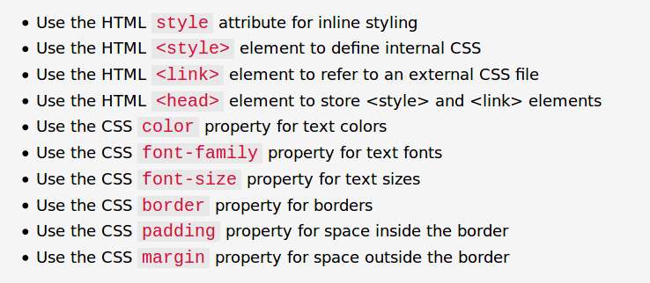

Slide 15
